Slide 1
Career Exploration: Teaching
Beth Grillo

Slide 2
Why I chose Teaching
I want to help young people discover their potential and become independent.
Teachers can help students learn how to make the world a better place.
Teachers have the most direct way to impact the greatest number of students on a daily basis.
I’d like to teach English since my students will need strong communication skills for every job they choose and every relationship they have.

Slide 3
Agenda/Topics to Be Covered
Why I chose teaching
Overview of career, including:
  What does a teacher do day-to-day?
  Education or certification needed to be a teacher
  Starting salary and opportunities for increasing salary
  A teacher’s schedule (i.e. 9-5, hourly, weekends, nights, etc.)
  Lifestyle that teaching will allow (i.e. family-friendly, not much time for social life, continuing education needed, etc.)
Budget overview
Where I’d like to be a teacher and why
Basic 5-year plan for becoming a teacher

Slide 4
  What does a Teacher do Day-to-day?
Develops and teaches lesson plans in a certain content area (math, English, AVID, Spanish, etc)
Interacts with students and provides support to them if they don’t understand or have a question
Provides a strong role model in the building for students
Interacts with other teachers and staff members to provide a professional place of work
Finds ways to improve the school experience for all
Talks to parents about their children’s progress

Slide 5

  Education or Certification needed to be a Teacher
Bachelor’s degree in English; minor in something
Teaching certificate in my state
  Pass basic certification test for English and/or my minor
  This will allow me to be a teacher legally anywhere in the state

Slide 6

  Starting salary and opportunities for increasing salary
In Michigan, the starting salary for a teacher with a bachelor’s degree and no experience is $46,660
  This varies depending on the district where I work.
  Utica Community Schools’ starting salary is $42,141.
  Rochester Community Schools’ starting salary is $41,828.
  Warren Consolidated Schools’ starting salary is $47,232.

Slide 7
  Starting salary and opportunities for increasing salary (continued)
There is opportunity for growth if
  I continue my education and get a Master’s degree, which will increase my salary.
  I become an assistant principal or principal.
  I become a coach of a sports team.
  I work at summer school or have a summer job.

Slide 8


  A Teacher’s Schedule
Teachers work during the school year, and a few days before school starts
Teachers do not work during school breaks, such as Thanksgiving, winter break, spring break, and summer break.
There are also some other days like Martin Luther King Jr Day, Memorial Day, and other federal holidays
Teachers usually do not work weekends.

Slide 9
  Schedule for someone doing job (continued)
However, teachers do a lot of work outside of the school day
  They grade papers.
  They lesson plan.
  They have meetings after school.
  Sometimes they attend conferences and workshops in the summer.
  Most of this time is unpaid.

Slide 10
  Lifestyle that Teaching will Allow
Teachers don’t make a ton of money, but they do get raises every year.
There are a lot of breaks for teachers throughout the year.
Teaching would be a good profession for someone with a family because they follow the school calendar.
Many companies and stores offer teacher discounts.

Slide 11
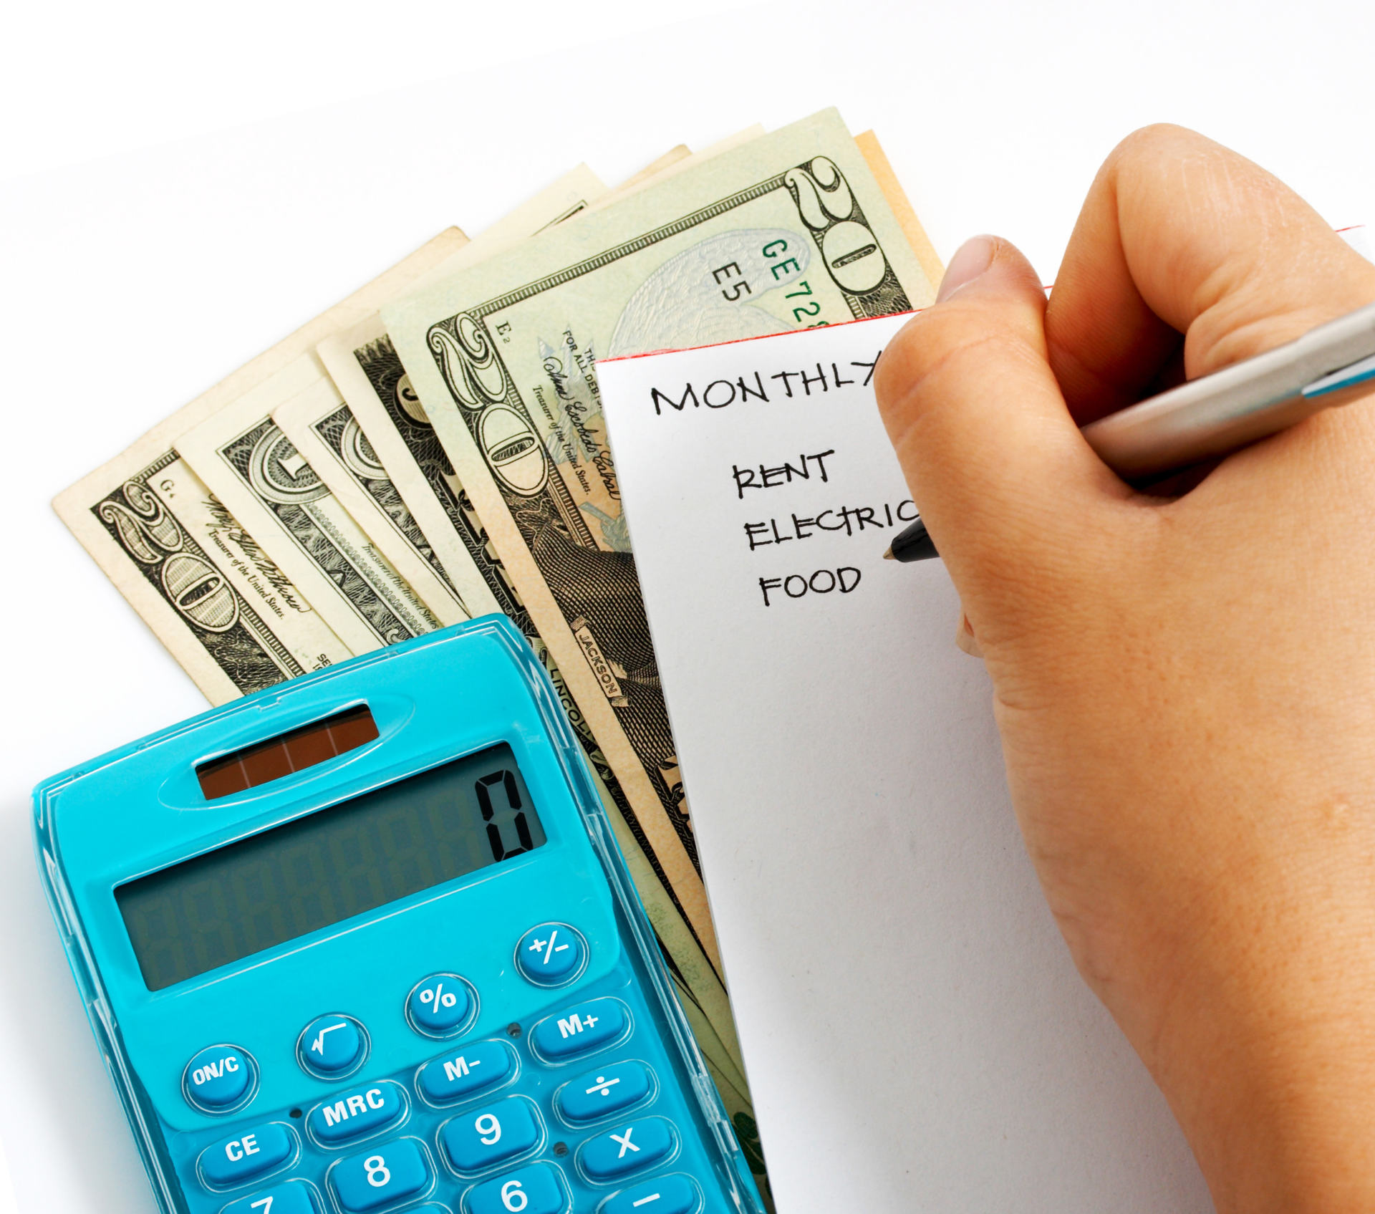
Budget overview
Income (money you make)
Gross Income (Salary) | $46,990
Monthly Gross (divide by 12) | $3,916
Taxes (-25%) | $979
Total Net Monthly Income | $2,937
Expenses (per month)
Rent / Mortgage | $1,425
Car Payment (add $150 for insurance) | $150
Monthly Bus/Train Pass (About $100)
Savings | $100
Daycare/Child Activities ($100 per child) | $0
Food - Groceries | $150
Food - Restaurants | $150
Utilities (gas, water, electrical) | $300
Cable / Streaming (Xfinity, Disney, Netflix, etc) | $100
Cell - phone | $100
Miscellaneous | $200
Total Expenses | $2,675
Income - Expenses | $262

Slide 12
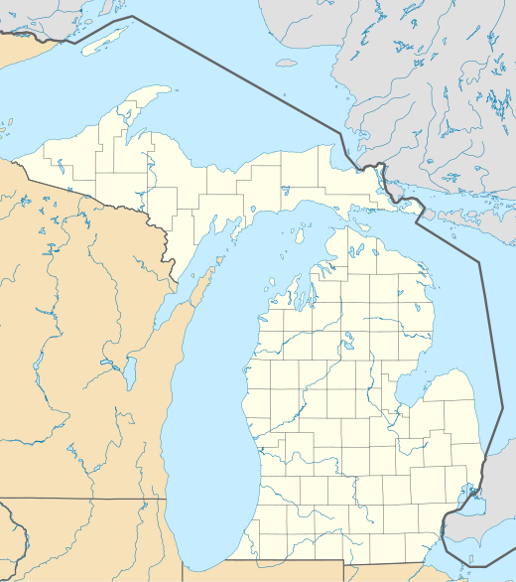
Where I’d like to be a Teacher and why
I would like to stay in Michigan and be a teacher.
  My family is here, and I want to live near them.
  I ski, so I would like to live somewhere that experiences winter.
  I want to live near water, and Michigan is surrounded by water.
  Cost of living in Michigan is relatively low.
This Photo by Unknown Author is licensed under CC BY-SA

Slide 13

5 Year Plan to become a Teacher
9th grade: Continue to focus on grades and start building my GPA. This will allow me to choose the best college for education that I can attend instead of having to attend any college that will accept me. Do well on PSAT 9 to get practice. Don’t get in trouble because that can be reported to colleges.
10th grade: Enroll in child development classes at my high school so that I can better understand how students learn and development. Do well on PSAT 10 to get practice. Don’t get in trouble!
11th grade: Enroll in Future Educators I and Future Educators Internship; Do well on SAT, which schools will see on my college applications. Visit college campuses and specifically colleges of education. Don’t get in trouble!

Slide 14
5 Year Plan to become a Teacher (continued)
12th grade: Continue in Future Educators II and Future Educators Internship. Apply to colleges that have strong and reputable education programs. Investigate financial aid and scholarships. Don’t get in trouble!
1st year of college: Meet with college guidance counselor to ensure that I am enrolled in the appropriate classes in my first year. Look for extra-curricular opportunities to learn about education and children. Find out when I can apply to the college of education (if I haven’t already)

Slide 15
THANK YOU!

